Slide 1
EMOTIONS AFFECTIVE EVENTS THEORY (AET)

Slide 2
Emotions in the Workplace
Emotions and mood can affect temperament, personality, disposition, and motivation.
They can affect a person's physical well-being, judgment, and perception. Emotions play a critical role in how individuals behave and react to external stimuli; they are often internalized enough for people to fail to notice when they are at work.
Emotions and mood can cloud judgment and reduce rationality in decision-making.

Slide 3
Emotions
Emotions are reciprocal with mood, temperament, personality, disposition, and motivation.
Emotions can be influenced by hormones and neurotransmitters, such as dopamine and serotonin.
Dopamine can affect a person's energy level and mood, while serotonin can affect critical-thinking skills.
The implication for behavior is important for both managers and subordinates to understand. Workers must try to identify objectively when an emotional predisposition is influencing their behavior and judgment

Slide 4
AFFECTIVE EVENTS THEORY (AET)
Howard Weiss and Russell Cropanzano developed this model in 1996.
Affective events theory attempts to explain the relationship between emotions and moods and job performance and satisfaction.
The theory begins by recognizing that emotions are a response to an event in the work environment.
Affective Events Theory (AET) is a psychological model designed to explain the connection between emotions and feelings in the workplace and job performance, job satisfaction and behaviours.

Slide 5
AET is underlined by a belief that human beings are emotional and that their behaviour is guided by emotion.
These work events trigger positive or negative emotional reactions.
The personality and mood predisposes individuals to respond with greater or lesser intensity to the event and will affect a number of performance and satisfaction variables.

Slide 6
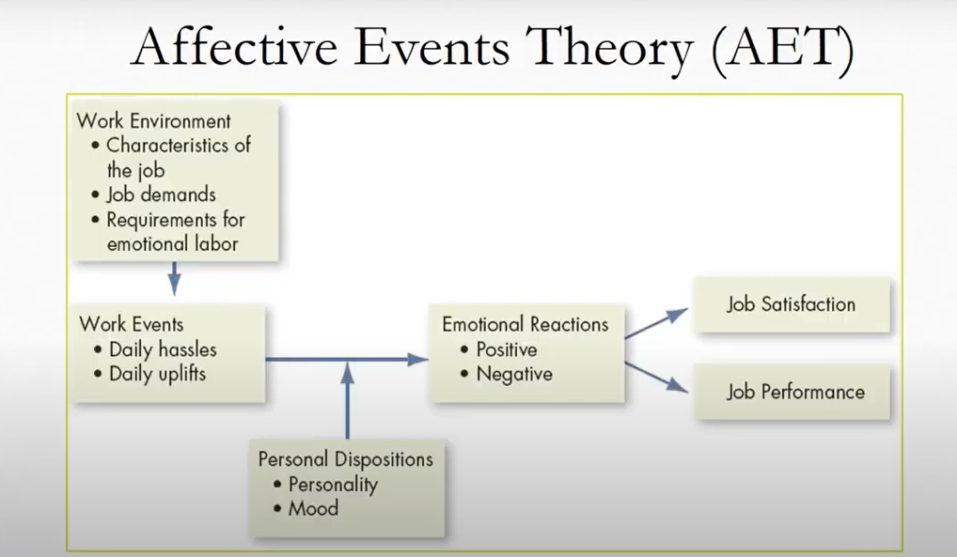

Slide 7
Affective Events Theory Assumptions
An affective state can be defined as the experience of feeling the underlying emotional state.
In simpler terms, a person who is controlled by a specific feeling.
For example, a person who makes a mistake on a test and then realizes it afterward might be rendered into an affective state where they cannot focus on anything else besides being upset about that mistake on the test.
AET centralizes around workers being impacted emotionally by events that occur on the job; therefore, emotions affect overall satisfaction and performance.

Slide 8
There are many parts of the job that might affect emotions such as job pressures, tasks, management styles, and/or co-workers' actions.
In AET, emotions are critically important to how employees handle workplace situations.
For example, if one has a manager who is always yelling, that employee is likely to be always on edge and have an emotional response to that yelling. This would in turn make it difficult for that employee to effectively do their job, thus resulting in poor job performance.

Slide 9
Affective Events Theory Applications
According to AET, there are two types of work events that can happen: positive or negative events.
These two events are equally as important for managers, owners, and supervisors to understand as to equate it with satisfaction and performance.

Slide 10
Negative AET Applications
If there happens to be a negative affective event in the workplace, it will then turn into negative behavior, thoughts, or performance.
A job where the tasks are routine, boring, or even overwhelming can be associated with a negative affective state. This in turn leads to lower job performance and satisfaction.
For example, Maryia's supervisor is always hassling her about her work. Her boss makes comments about her doing better and yelling at her about submitting work. These events are considered negative applications. Maryia, in turn, does not want to do better because she is experiencing negative emotions toward not only her boss but the job in general.

Slide 11
Positive AET Applications
Positive applications of AET, such as uplifting emotions, motivation can positively affect employees.
For example, a boss who is always uplifting and rewarding to all employees is likely to have employees who want to do better and be better at the job.
Those employees are likely to have high job performance and job satisfaction.
Managers or bosses who provide opportunities for enrichment and the development of new skills related to that job are often likely to induce positive affective states. That increase can help satisfaction and performance.

